Slide 1
Python
Beginner’s Night
Women Who Code DC – Oct 2019

Slide 2
We are Women Who Code!
Women Who Code (WWC) is global non-profit dedicated to inspiring women to excel in technology careers. We work to support this generation in being and becoming leaders and role models in the tech industry.
We are the DC Chapter!
Volunteer / Donate
Visit our Meetup site
Python Beginners: 1st Wednesday of the Month; Python Hack Night: 3rd Wednesday of the month

Slide 3
What is Python?
Powerful scripting language that offers simplicity and flexibility
Easy to learn syntax
Used in simple and complex programming
Has a large family of libraries to support a variety of science, math, and engineering applications
The Python community provides a variety of tools for common applications.
Scripts well in various programs/projects – ESRI ArcGIS,
Notes:
Scripts well in various programs/projects – ESRI ArcGIS, web development, Linux OS, desktop based apps, YouTube, DropBox, NASA scientific work, Game development, GUI development

Slide 4
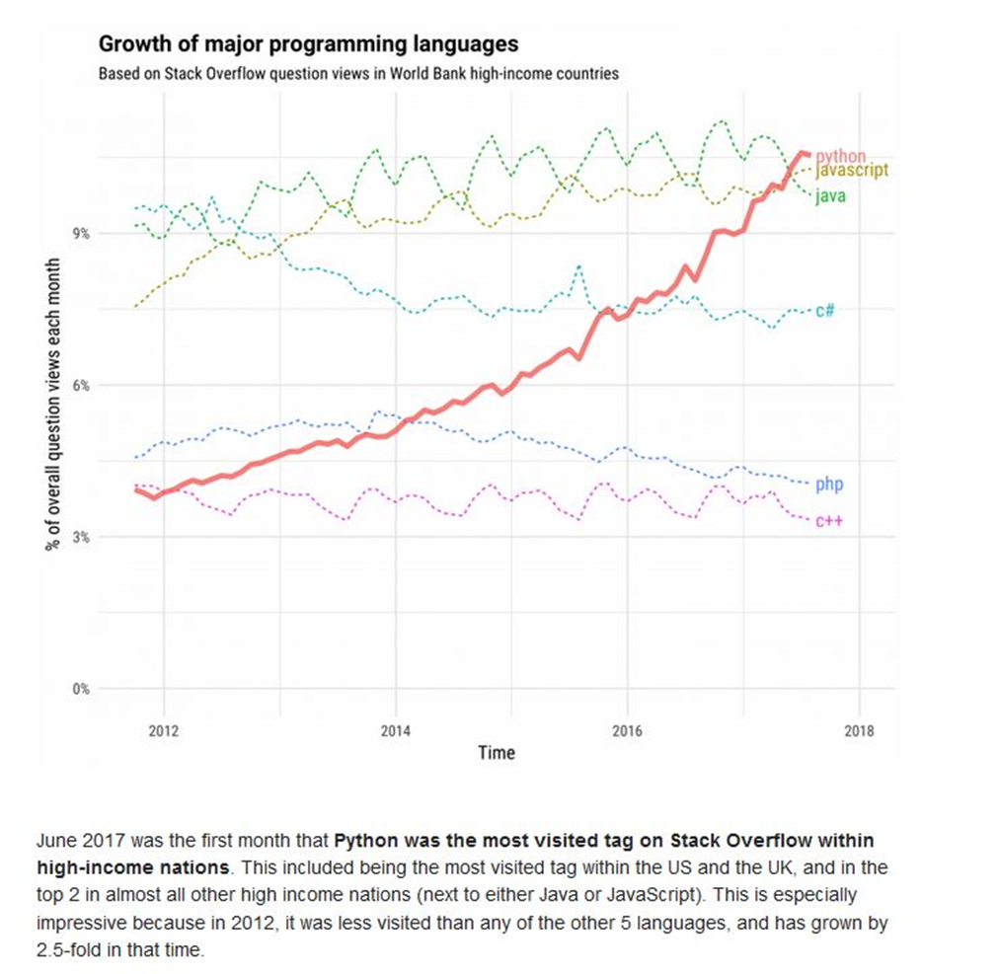
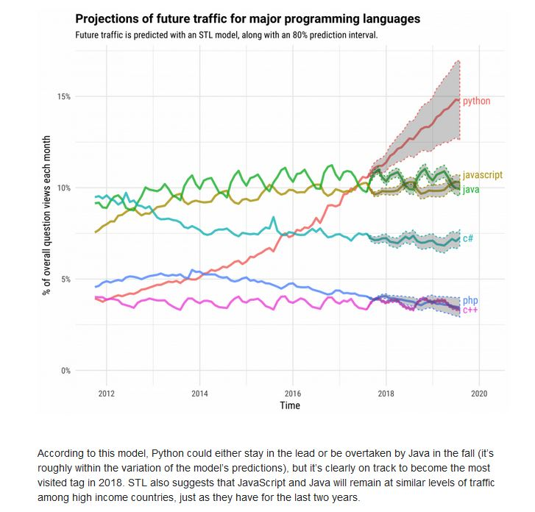
2017 Predicted Growth
of Python

Slide 5
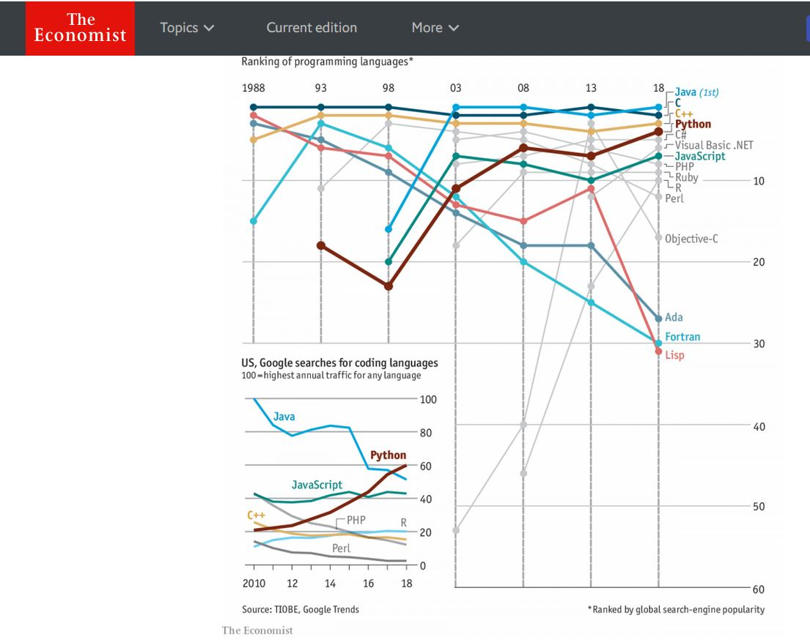
2018 Popularity Ranking
of Programming
Languages

Slide 6
Tools You Need
Python interpreter –To run Python programs on PCs, Macs, and Linux machines & Text Editor - Program to edit your code.
OR
Online virtual Python environment
AND
Motivation & commitment to learn a new skill

Slide 7
Google’s Colaboratory
Don’t have to download Python - NO setup, just start coding
A free Jupyter notebook environment that requires no setup and runs entirely in the cloud.
Write and execute Python code
All for free from your browser. Just need a Google account.
Will be saved as a ipynb file
Saved to your Google drive

Slide 8
Get Started with Colaboratory
Login into you Google account
Access your Google Drive
On leftside of dashboard click on”+ New”
Select on “Folder” to create new folder to hold your Colab notebooks
TO CREATE NEW Colab notebook (ipynb file): Access your new folder and click on “+ New” then on “more” to create a Google Colaboratory notebook
UPLOAD a ipynb file to your Google Drive and save into your new folder, open with Colaboratory

Slide 9
To start coding
Type into cell your code and do RunTime -> run the focus cell OR Ctrl+Enter
Clear output – select output and click on X
Create either a code cell or text cell

Slide 10
3 Components in Coding
Syntax
Data Structures
Reference Library of methods, functions, framework

Slide 11
Syntax - Define a Function
Returns a result
def addUp (a, b):
total = a + b
return total
Execute code - returns no results
def read_fineprint ():
print (“This is the fine print of the contract…….”)
SYNTAX
def functionname( parameters ):
statement 1
statement N
return [result]
SYNTAX
def functionname():
statement 1
statement N
4

Slide 12
Data Structure – If/Else
SYNTAX
if expression(T or F) :
statement
if condition is TRUE then execute statement
if NUM > 0:
print (“this number is bigger than zero”)
If NUM == 52:
print (“this number equals 52”)
NUM = 52

Slide 13
IF condition is TRUE then execute #1 ELSE is FALSE and execute #2
SYNTAX
if expression(T or F) :
statement 1
else:
statement 2
if NUM > 0:
print (“this number is bigger than zero”)
else:
print (“this number is smaller than zero”)
if NUM == 52:
print (“this number is 52”)
else:
print (“this number is not 52”)
NUM = -3

Slide 14
IF condition TRUE execute #1 ELSEIF condition #2 TRUE execute #2 ELSEIF condition #3 TRUE then execute #3 …… ELSE all FALSE execute #N
if NUM > 1000:
print(“Jackpot!”)
elif NUM > 800:
print(“Big Money!”)
elif NUM > 500:
print(“Nice Money!”)
elif NUM > 250:
print(“Money!”)
else:
print(“Grocery Money”)

Slide 15
IF Elif Else code to add
if num ==1:
result = celsius_to_fahrenheit(temp)
print (str(temp)+ " celsius to fahrenheit: ")
elif num ==2:
result = fahrenheit_to_celsius(temp)
print (str(temp)+ " fahrenheit to celsius: ")
else:
result = 0
print("Temp code not valid:")

Slide 16
Python Standard Library
Go to :
https://www.python.org/

Slide 17
Beginner Tips
Practice a lot
Understand the code (syntax, format, libraries, functions, classes, packages)
Start slow – its okay if you don’t get right away
Try to solve code issues on your own first then reach out
Help out your team mates – repetitive learning.
It will take time to develop your skill and tool set – Testing code, debugging techniques and using an Integrated Development Environment (IDE)

Slide 18
Some Python Resources
Coursera
HackerRank
StackOverflow
Slack
CodeCombat
GitHub
How to Think Like a Computer Scientist
Learn Python the Hard Way

